Slide 1
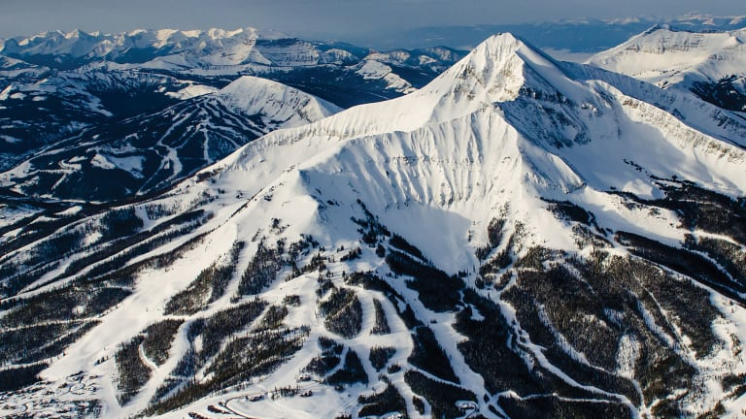

Big Mountain’s Ticket Pricing Modelling
Anne Warren

Slide 2
Ticket Pricing Rationalization
What are the opportunities available this season for Big Mountain Resort to realize its competitive advantage and to rationalize its ticket pricing strategy?
Context
Constraints within solution space
Rationalize ticket pricing strategy to absorb new operational costs while allowing budget for future investments in equipment.
Welcome operational changes that benefit the ticket value.
Implementation of new ticket pricing may not be possible due to local market.
The unpredictable nature of weather and visitor behavior may affect the success of implemenations.
Criteria for success
Stakeholders
New ticket pricing to be implemented this season.
Identified opportunities for equipment modification to be delivered for evaluation to leadership.
Jimmy Blackburn, Director of Operations.
Alesha Eisen, Database Manager.
Scope of solution space
Key data sources
Resort amenities to be reviewed and compared to 330 competitor data across the US
Model ticket pricing and model the impact of modifying features on ticket price.
Provided by Alesha Eisen.
Resort data from 330 ski resorts in the US.

Slide 3
Key Findings & Recommendations
$81
Modelling Current Features
$93
$103
+450 ft Vertical Drop
assuming 350,000 visitors per season, 5 tickets per visitor
Ticket Pricing
Adding New Features To Increase Value
The predicted Adult Weekend Ticket is $93.32 (+/- $10.32).
Expected increase because Big Mountain ranks high on most of the league charts of facilities offered.
An increase in ticket price deepens the gap with other ski resorts in Montana.
The model can be refined using additional data describing Big Mountain’s visitors and the visitors of comparable resorts.
Permanently closing-down runs undermines the ticket price.
Increasing the longest run by 0.2 mile has no impact.
Increasing the vertical drop by 300 up to 600 feet with the addition of necessary equipment improves the ticket price from $5.17 up to $13.20 and revenue by $9,054,348 up to $23,105,072.
Adding vertical drop is sustainable when each visitor buy only two tickets per season.

Slide 4
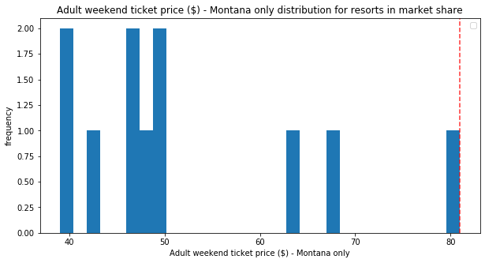
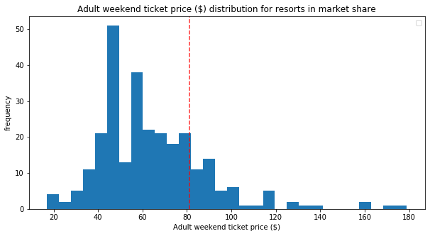
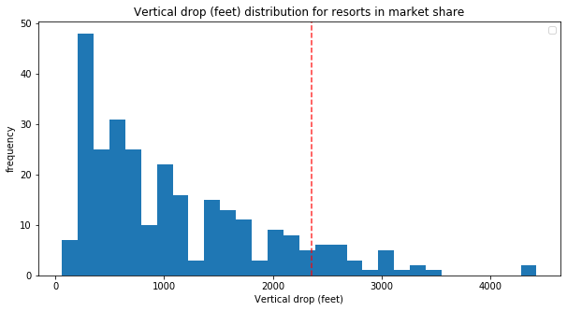
Modelling Results: Big Mountain’s Rank in the Market
Ticket Price in Montana
Big Mountain Resort is the high-end ski resort in Montana and belongs to the upper national market share.
It ranks among the best resorts in the nation in terms of artificial snow coverage, skiable terrain area, numbers of chairs, numbers of fastquads, numbers of runs and even owns one of the longest run.
Only one feature, the vertical drop (2,353ft), is not ranked amongst the best (i.e. 3000+ft).
Big Mountain
Ticket Price in USA
Vertical Drop
Big Mountain
Big Mountain

Slide 5
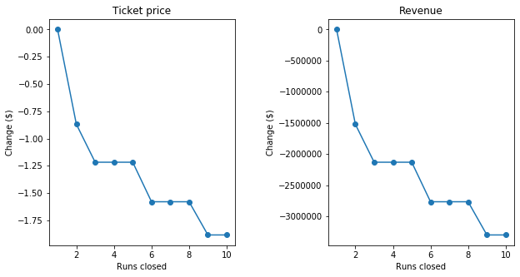
Modelling Results: Adding or Removing Runs
Permanently closing-down runs undermines the ticket price and hence decreases revenues.
Beyond 2 runs, a stepwise pattern emerges. Closing 3 runs has the same effect as closing 4 or 5 runs. The same goes for 6, 7 and 8 runs.
Increasing the longest run by 0.2 mile has no impact.

Slide 6
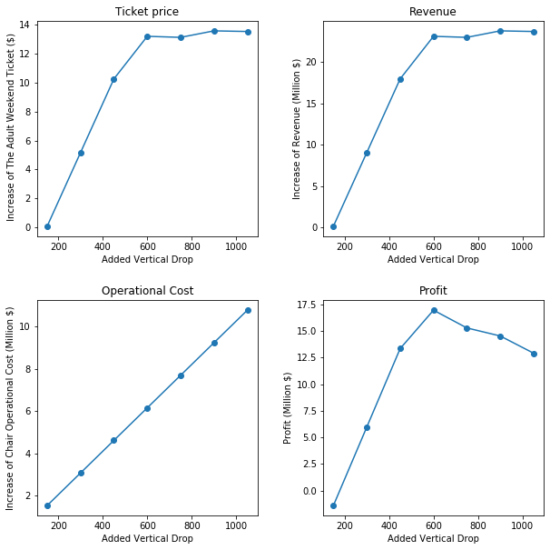
Modelling Results: Adding Vertical Drop
The impact of increasing the vertical drop with the addition of required equipment (1 chair, 1 run and 2 acres of snow per 150 feet of vertical drop) has been modeled assuming 350,000 visitors and 5 tickets per visitor.
Increasing the vertical drop by 300 feet up to 600 feet improves the ticket price by $5.17 up to $13.20 and the seasonal revenue by $9,054,348 up to $23,105,072.
Profit goes up to 17 millions dollars (NB: operational cost include only chairs).
Adding more than 600 feet of vertical drop does not provide additional income.

Slide 7
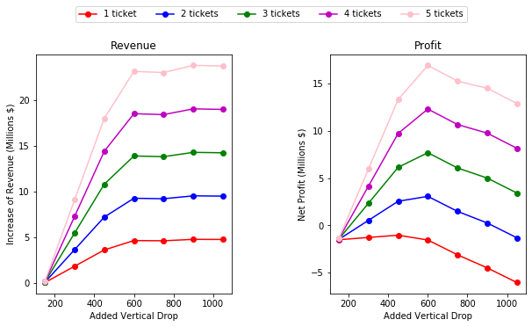
Sustainability of Change
The addition of vertical drop seems sustainable in a less favorable market provided at least 400 ft is added.
The total operational cost of such feature should be evaluated in details.

Slide 8
Summary & Conclusion
The model was developed using a Random Forest Regression on data from 276 ski resorts located in the US. The model assumes, unless stated otherwise, that Big Mountain will welcome 350,000 visitors per season and that each visitor will buy 5 tickets. The model successfully rationalizes ticket pricing and provides valuable insights on key drivers of revenues.
Ticket Pricing
Recommendations
Charging $81 per adult weekend ticket, Big Mountain Resort is the high-end ski resort in Montana and belongs to the upper national market share.
It ranks high on the league charts in the exception of vertical drop
Big Mountain Resort may increase the ticket price by at least $10 to reflect its value within the US market.
An increase in ticket price could deepen the gap with other, less expensive, ski resorts in Montana.
The model could be refined using additional data about visitors (i.e. origin, purchases, visit frequency) in Montana and in other states for resorts offering comparable features.
Profit calculation can be refined using relevant data pertaining to operation and installation cost.
Adding Value with New Features
Exploring the Results
Big Mountain may improve revenues by adding 400 to 600 feet of vertical drop, with the necessary chairlifts, runs and snow makers.
This would be sustainable provided Big Mountain welcomes 350,000 visitors and each visitor buys at least two tickets.
The model and data have been loaded in Power BI.
A dashboard is available for you to test out different scenarios here.
I can be reached @ 111-222-3456 or via email datascientist@dscience.com

